Slide 1
I can structure lesson plans to help students reach goals
I can create new activities from raw content

Slide 2
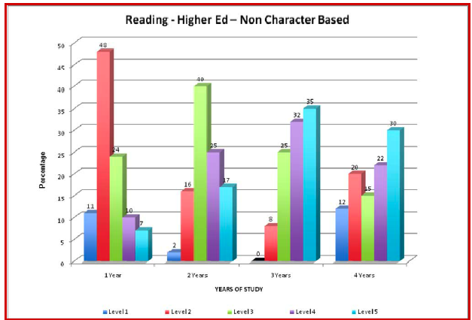

Slide 5
STAMP 101
• Created to enable statewide policy
• Online: Anywhere, anytime, anybody
• Computer adaptive reading/listening
• Computer assisted speaking/writing

Slide 6
FSI/ILR
ACTFL
5
4+
Superior
Benchmarks
4
3+
Advanced
Benchmark 6
3
Pre-Advanced
2+
2
Benchmark 5
Intermediate
Inter- mid
mediate low
1+
Benchmark 4
1
0+
Novice
high
Novice mid
low
Benchmark 3
0
Benchmark 2
Benchmark 1

Slide 7
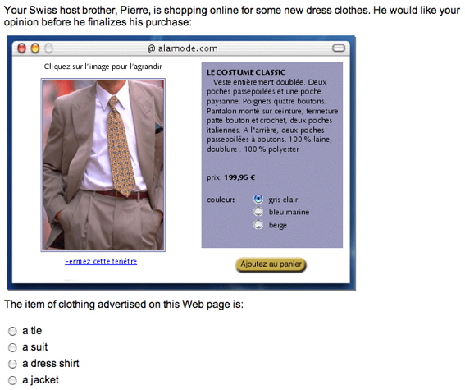
Sample Reading Item
French

Slide 8
Notes:
Writing sample, all languages

Slide 9
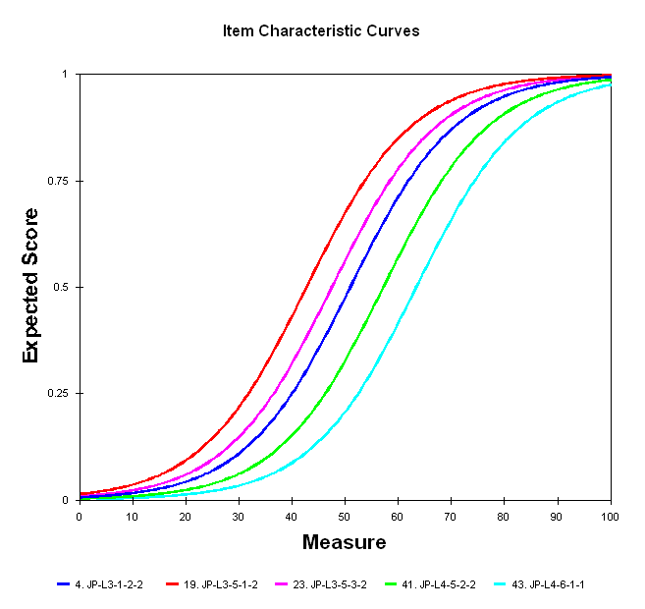
Level 3
Level 4

Slide 10
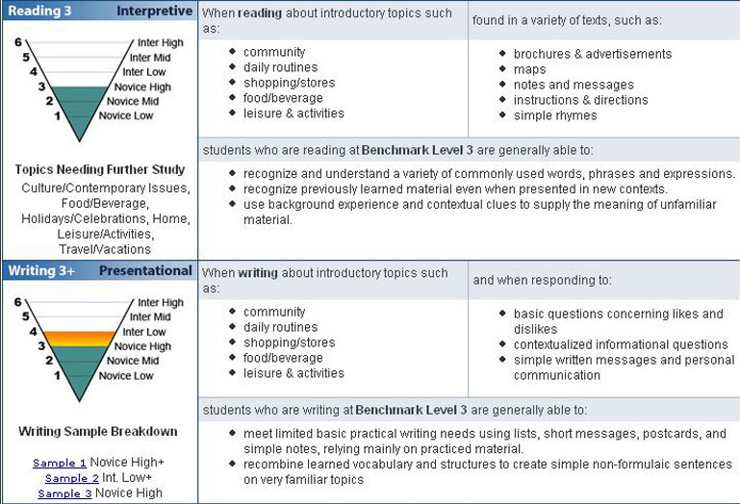

Slide 11
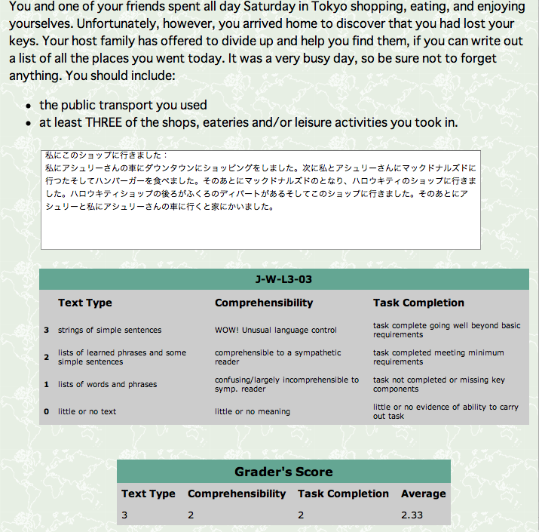
Dan’s Writing

Slide 12
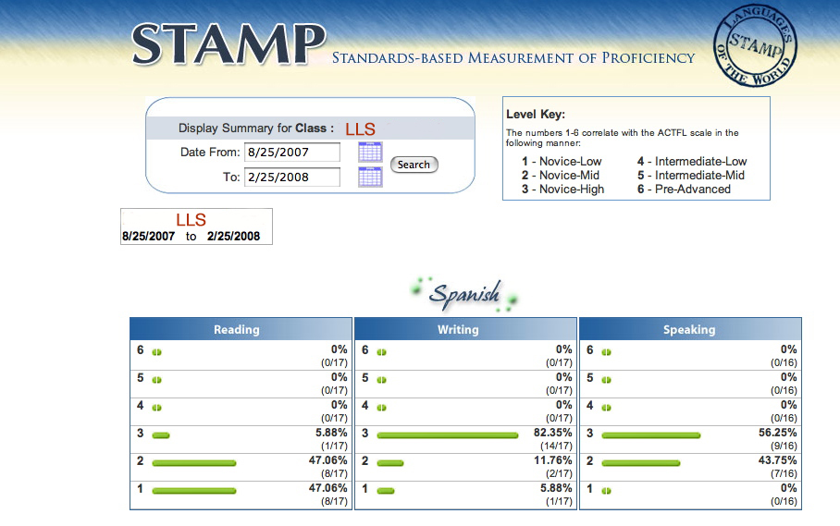
Sample Class Summary Results Report

Slide 13
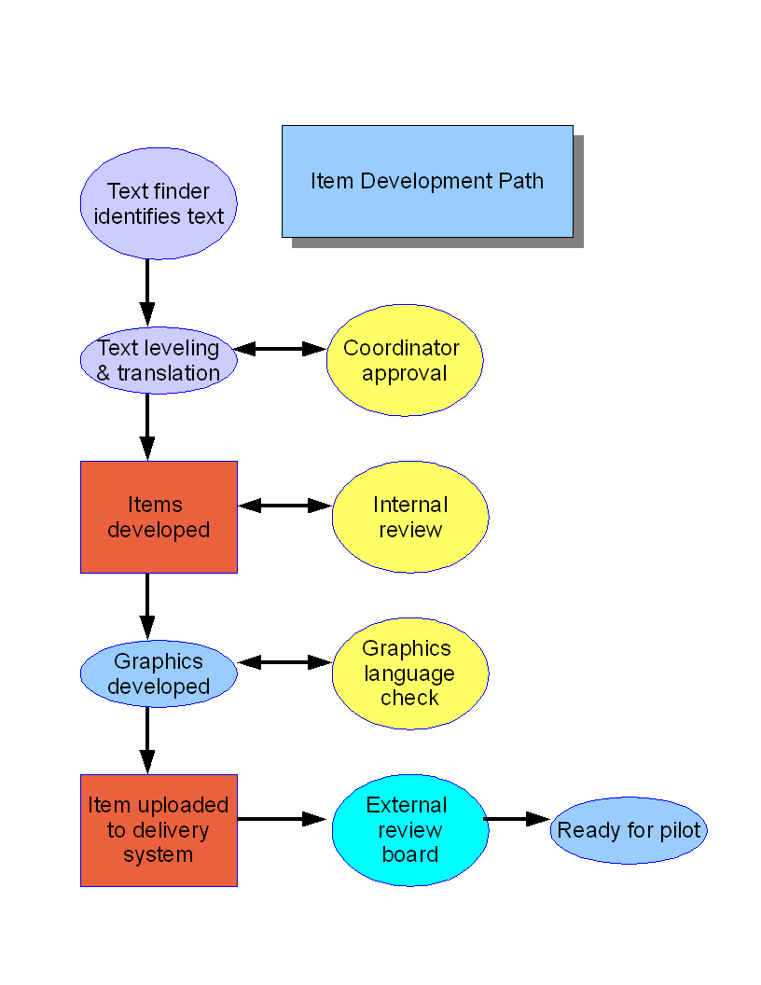
Notes:
This illustration depicts the “ideal” version of the new test development procedure at CASLS. The actual process is, of course, much more recursive than this.
13

Slide 14
I can ask for and understand directions to a public bathroom.

Slide 18
Objectives | CanDo Statement(s)
Topic | directions | Context | Finding a restroom
Materials | Japanese signs, map materials
Task | In pairs, students will give verbal directions to the restroom.
Performance Standard | Students will direct their partners to the correct map location.

Slide 19
Objectives ‘aaaaaaaa
Topic | Directions | Context | Need to find restroom
Presentation | Activate background knowledge, introduce new material (including grammar, vocabulary), model language use
Input | Proof of processing
Guided Practice | Modeling, teacher feedback
Independent Practice | Pair work/group work/homework
Evidence Task | Task will produce evidence of ability

